Slide 1
Information for Assignment One
Simple Example for Assignment 1 with Handcrafted Feature

Slide 2
Software
Install Anaconda (https://www.anaconda.com/)
After installation, open Jupyter Notebook
Note: All the softwares, program languages and packages in this slices are just a showcase.

Slide 3
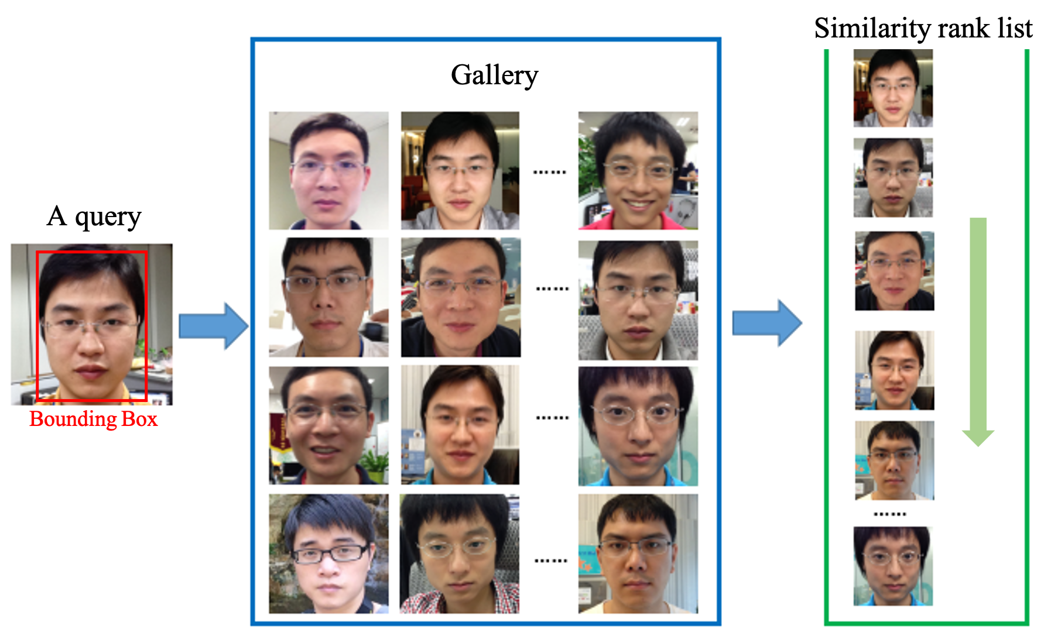
An example diagram for instance search.
In every bounding box file (the txt files), each line records the coordinates of one bounding box in format: x of top-left point, y of top-left point, width, height.
The bounding box information is only provided for the query images.
Notes: it's possible that there are more than one instances in a query image (see the annotation(s) in the corresponding txt file), you should find the most similar image rank list in the gallery by considering all the instances.

Slide 4
Import Packages
Import the packages you need
Just an example here

Slide 5
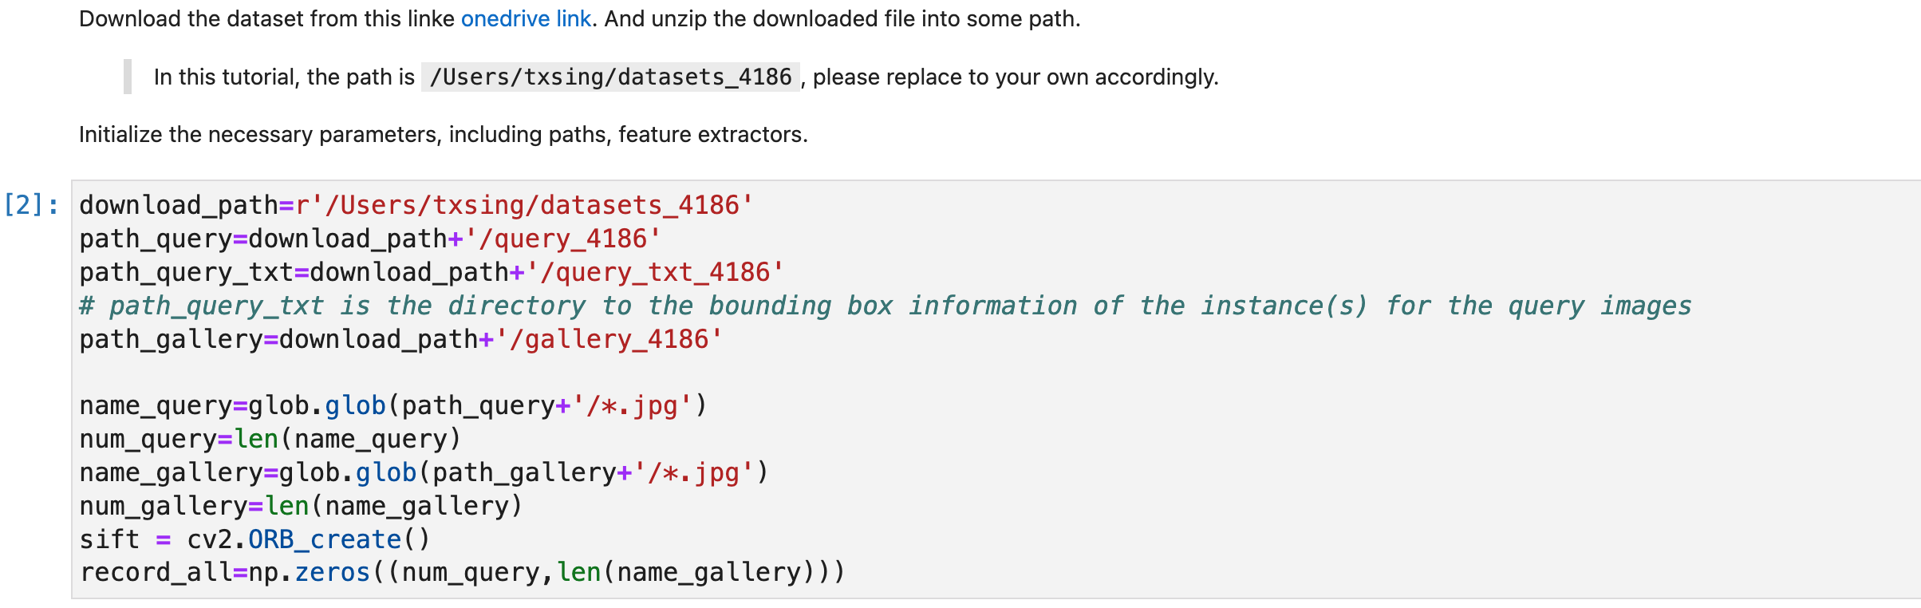
Input and Preparations
Initialize the necessary parameters, including paths, feature extractors.
The path names are dependent on your own setting and could be flexible.
An example on my machine
Detail meanings are commented in along with the codes, the rest of the slide is the same

Slide 6
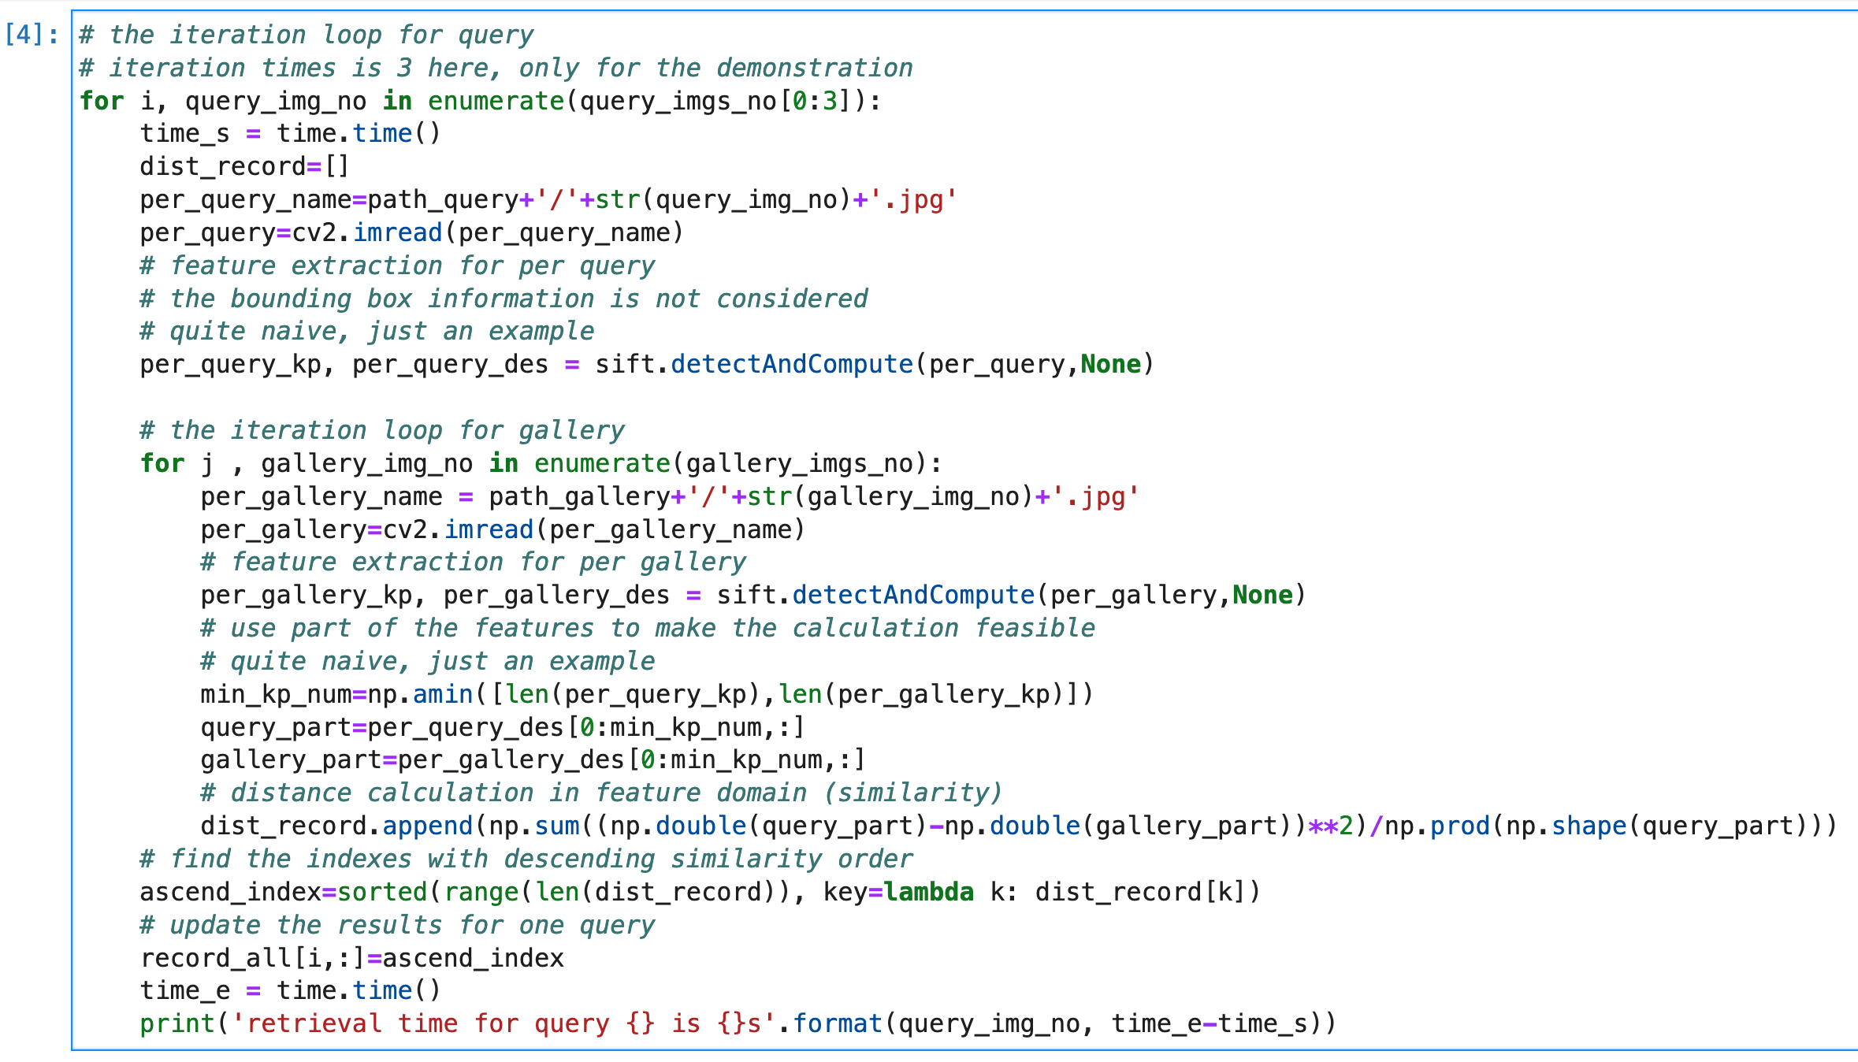
Process
Feature extraction -> calculate distance -> compare
The retrieval time here is just for information, not mandatory in your submission.

Slide 7
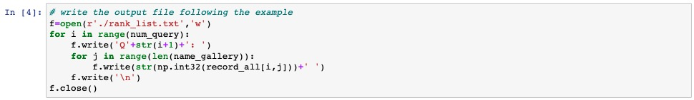
Output
Save the rank list file.

Slide 8
Full script
The full script is named as rank_list.ipynb, which is in the same folder and could be opened with Jupyter Notebook.

